Slide 1
Front End Engineering-II Project
SAARTHI
Ridhi Bhatia, 2310990946
Samriti Chauhan, 2310990958
Class Group: G12 Project Group No.: PG7
Faculty Coordinator
Dr. Mahesh Prasad
Chitkara University Institute of Engineering and Technology,
Chitkara University, Punjab

Slide 2

Table of Contents
Introduction
Technical Details
Problem Statement
Key Features
Project Highlights
Conclusion
References/Links used

Slide 3

Introduction
Creating a tour and travel website is an exciting project that will inspire and assist travelers in planning their dream adventures. The goal is to design a visually appealing and user-friendly platform where users can easily explore destinations, find personalized recommendations, and book trips effortlessly. With a focus on seamless navigation and engaging content, this website will become a trusted resource for anyone looking to embark on their next journey, offering everything from destination guides to booking services in one convenient place. Additionally, the platform will include a blog section with travel tips, destination highlights, and insider advice, enhancing the user experience with valuable content. With its blend of functionality and inspiration, this tour and travel website will simplify trip planning and ignite the wanderlust in every visitor.

Slide 4

Technical Details
The functionality of website showcases essential features of the Travel and Tour Website:
Different Locations: Our website provides user different locations to travel which are both domestic as well as international.
Interactive UI: A user friendly interface makes it easy for users to navigate, vote and explore contestants information.
Support and Help: Users can give their feedback related to any issue in the Contact Us section pinned on the home page.

Slide 5

Problem Statement
The travel and tourism industry is growing rapidly, but many websites lack user-friendly interfaces, accurate information, and personalized experiences, leading to frustrated users and missed business opportunities.
1. User-Friendly Interface:
- Simple navigation and effective search features
- Clear and concise content presentation
- Optimized for mobile devices
2. Accurate Information:
- Updated travel guides for various destinations
- Dependable booking details and pricing
- Real-time availability and itineraries

Slide 6
3. Personalized Experience:
- User profiles and tailored preferences
- Customized suggestions and recommendations
- Personalized promotions and special offers
4. Destination Guides:
- Detailed information about different destinations
- High-quality visual content, including images and videos
- User-generated reviews and ratings
5. Booking and Payment:
- Secure processing of payments
- Convenient booking and cancellation procedures
- Transparent policies and associated fees

Slide 7

Key Features
Key elements that make a travel and tour website truly successful include:
Responsive Design.
Search and Discovery.
Easy cancellations with the refund.
User-friendly interface.
Increase customer loyalty.

Slide 8
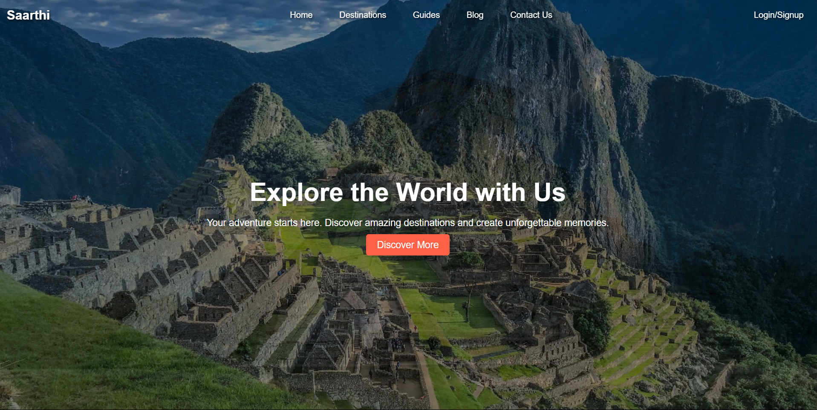
Project Highlights
The figure shows our home page of our website in which user can navigate the various sections such as Destinations, Guide, Blog, Discover More and even they can Contact Us if he faces any kind of issue.

Slide 9
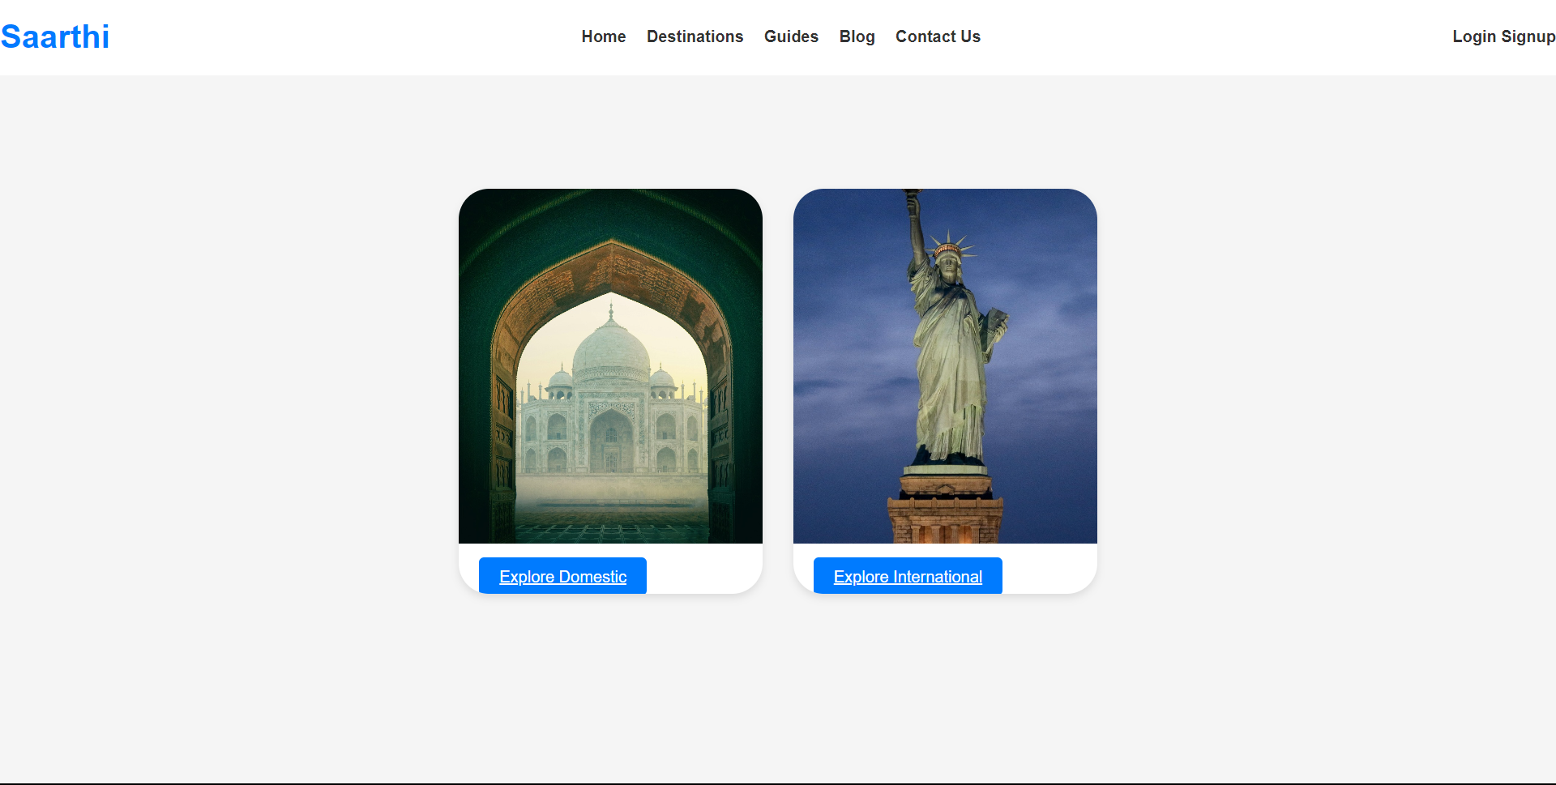
Project Highlights
The figure shows the destinations page of our website in which user can explore various Domestic or International places for travelling by clicking on Explore More button.

Slide 10
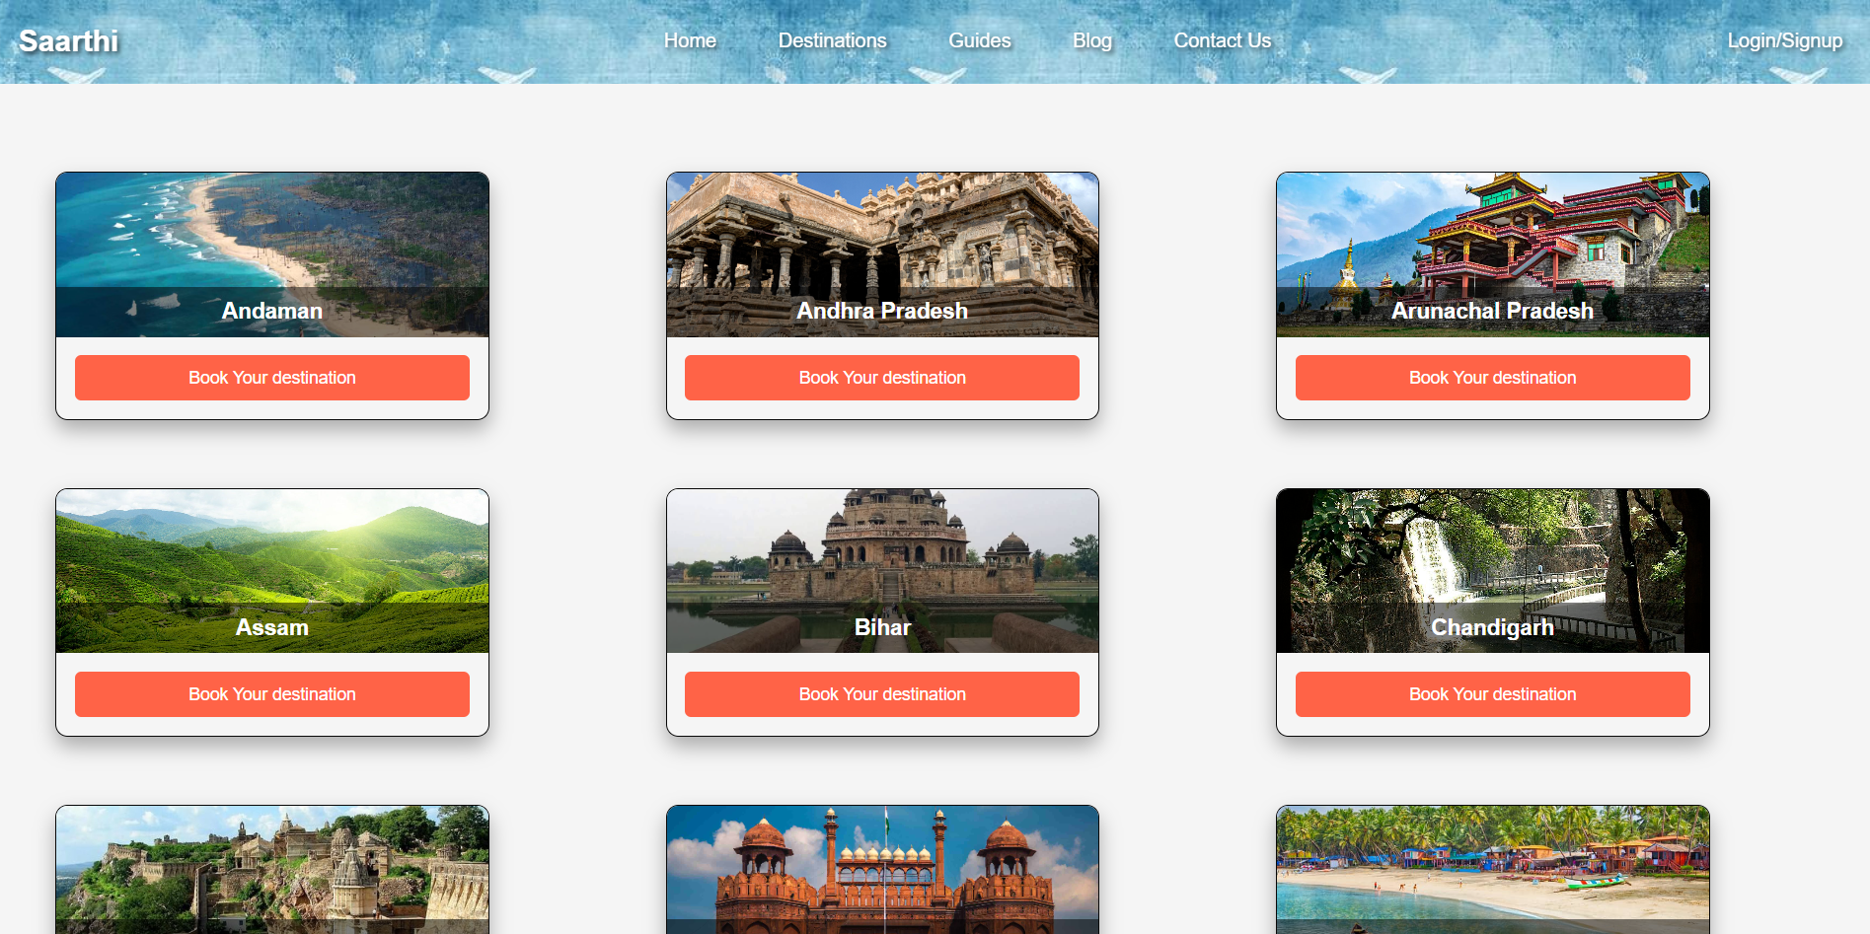
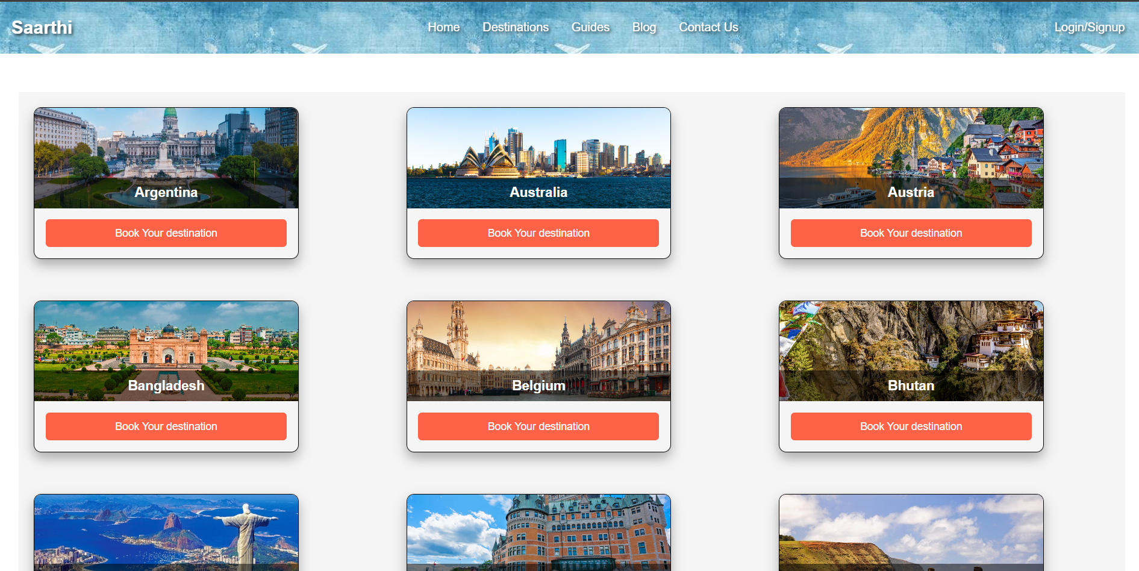
Project Highlights
Domestic Page
International Page

Slide 11
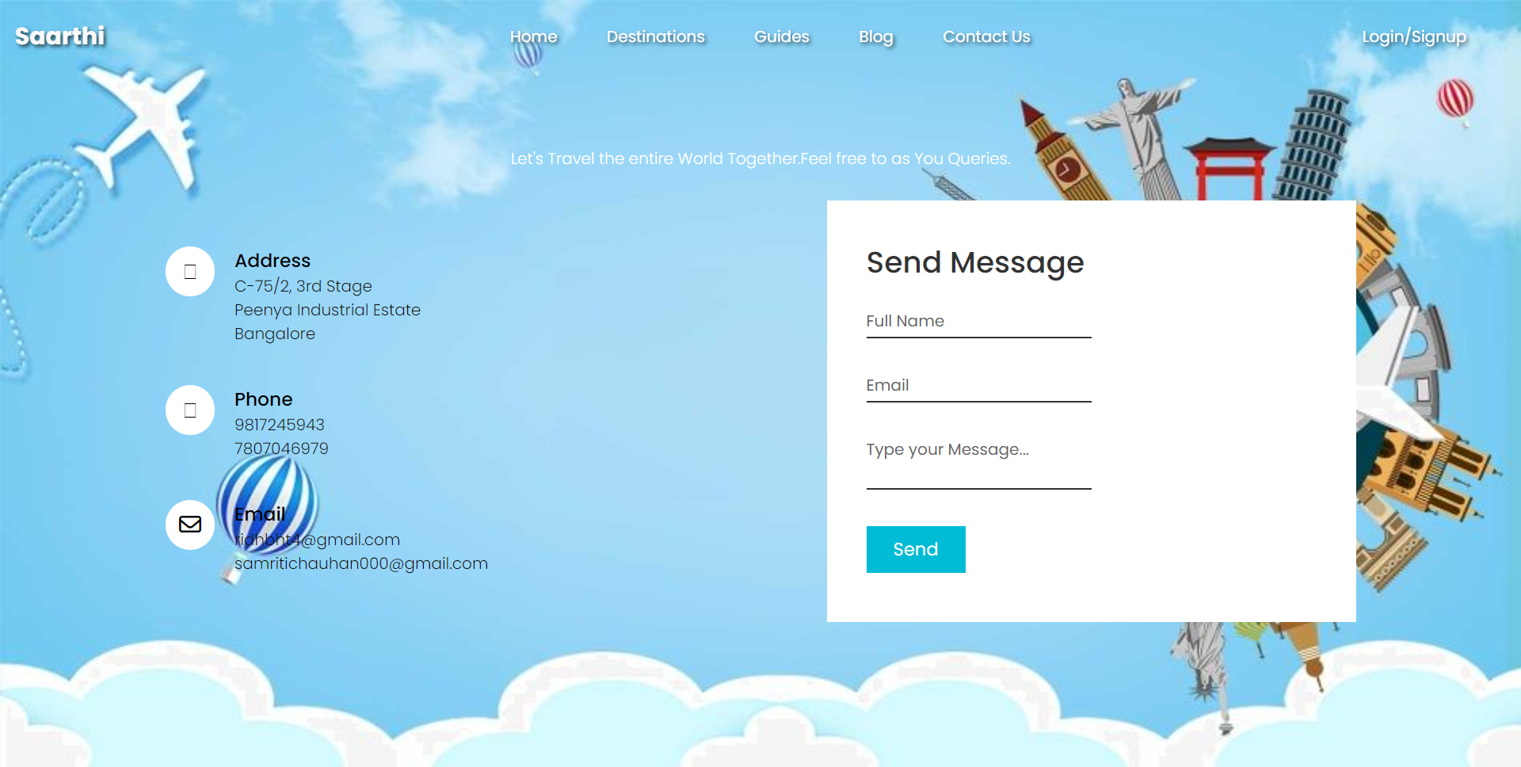
Project Highlights
This is the contact us page of our website in which user can contact us through various modes.

Slide 12
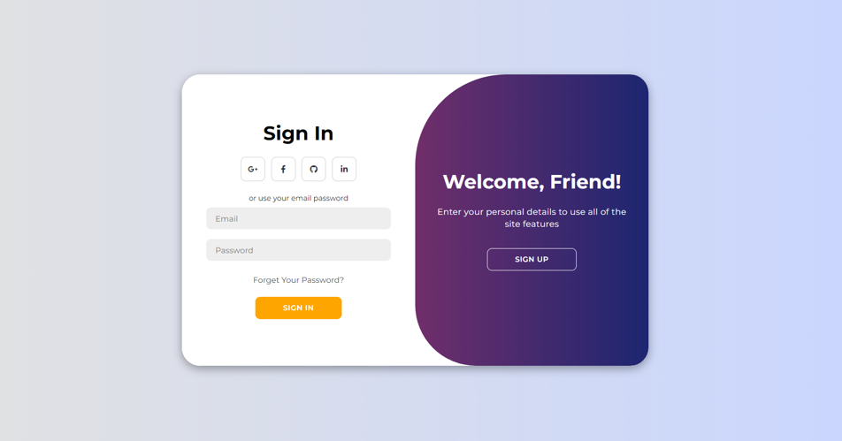
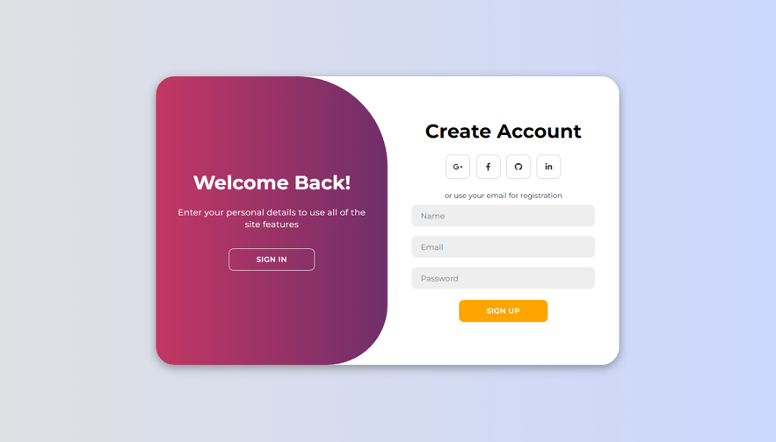
Project Highlights
This page allows user to login/signup their ids.

Slide 13
Conclusion
In conclusion , the web blog development project aims to create a fantastic place for people to share their thoughts and stories online. It will have cool features like customizable designs, ways to make money, and tools to help you connect with readers. Whether you're a blogger or a reader, this project is all about making your experience on the internet more fun and enjoyable.

Slide 14
References/Links used
Links used in the project are from the following sources:
1. www.google.com
2. https://www.w3schools.com/html/html_css.asp
3. http://faraz.com

Slide 15


